Slide 1
course project
Analytics Tools & Decision Making

Slide 2











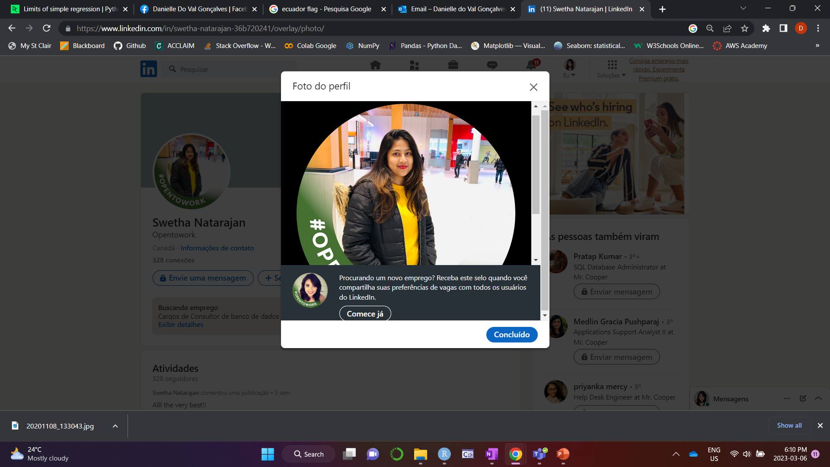
Our group
Danielle do Val
Goncalves Tudeia
(Brazil)
Eduardo Chavez Barrientos
(Mexico)
Jonathan Alberto Calle Zuniga
(Ecuador)
Jonathan Chukwuma Oteh
(Nigeria)
Mostafa Issa Mahmoud Kanaan
(Jordan)
Swetha
Natarajan
(India)

Slide 3

background
Massachusetts, US
#13
state in US with the most residents losing money due to data breach, only in 2020 were almost $100 million
2007
was approved the regulation that requires companies to report data breaches affecting residents' private data
+2X
+5.5X
As of 2022, the average cost of a data breach in the United States was US$ 9.44 million, twice the global average.

Slide 4

PROBLEM
Companies in Massachusetts are facing an exponential increase in data breaches in recent years. Since 2007, a new regulation requires them to report these events, but even so, the numbers show that they do not seem to be more prepared now than a few years ago and are spending a lot money in lawsuits and collective actions brought by residents whose data was stolen.

Slide 5

proposal
Our goal is to support companies in Massachusetts with information about data breaches so they can be better prepared to prevent them and, if they occur, create procedures to mitigate the impact on whose data was stolen.
What are the Top 3 companies that suffered most of the data breaches and what is the trend for these companies?
What type of data stolen through data breaches presents the greatest growth over the years?
What type of data stolen through data breaches has the greatest impact on the population of Massachusetts?

Slide 6
UNDERSTANDING THE DATa
Content
The dataset summarizes the breaches affecting residents’ private data reported to the Office of Consumer Affairs and Business Regulation (OCABR) by companies in Massachusetts, US from 2016 to 2022.
Source
The dataset was collected through the official website of the Commonwealth of Massachusetts. Available at: https://www.mass.gov/lists/data-breach-reports.
Information
The dataset has the information about the data breaches of SSN, Account number, Driver’s licenses, and Credit/Debit numbers affected. Also considers stolen mobile devices and credit monitoring.
Disclosure: The number of residents affected may go up as companies determine the total number of impacted residents.

Slide 7
UNDERSTANDING THE data
Categorical Data
Feature | Content
Source.Name | Collective report of data breached for the different companies
Organization Name | Different organizations who data has been breach
Breach Type Description | Type of data breaches
Breach Occur at the Reporting Entity? | Provides information if the data breach were reported to institution or not
SSNBreached | If the Social security number has been breached or not
Account Number Breached | If the Account Number of the customer from the institution has breached or not
Drivers Licenses Breached | If the Drivers Licenses of the customer from the institution has breached or not
Credit Debit Numbers Breached | If the Credit/Debit Numbers of the customer from the institution has breached or not
Provided Credit Monitoring | Has the credit monitoring services have been provided
Mobile Device Lost Stolen | Provides information if the mobile is lost or stolen
Data Encrypted | If the data has been encrypted in data breach
Unique
Feature | Content
Assigned Breach Number | Distinctive number assigned to a report by OCA
Application Dataset
Numerical/Date Data
Feature | Content
MA Residents Affected | It’s the count of MA resident affected by data breached
Date Reported To OCA | Reporting date of data breached to OCA

Slide 8
UNDERSTANDING THE DATA
File Format
The dataset was created from 7 pdf files grouped in an Excel file (xlsx)
Missing Values
Column Name | Number | % | Next Step
Breach Type Description | 29 | 0.2% | Delete
Breach Occur at the Reporting Entity? | 6,373 | 44.2% | Replace with “No”
MA Residents Affected | 85 | 0.6% | Delete
SSNBreached | 7,645 | 53.0% | Replace with “No”
Account Number Breached | 10,165 | 70.5% | Replace with “No”
Drivers Licenses Breached | 12,315 | 85.4% | Replace with “No”
Credit Debit Numbers Breached | 8,237 | 57.1% | Replace with “No”
Provided Credit Monitoring | 6,363 | 44.1% | Replace with “No”
Data Encrypted | 14,422 | 100.0% | Ignore the column
Mobile Device Lost Stolen | 14,296 | 99.1% | Replace with “No”

Slide 9
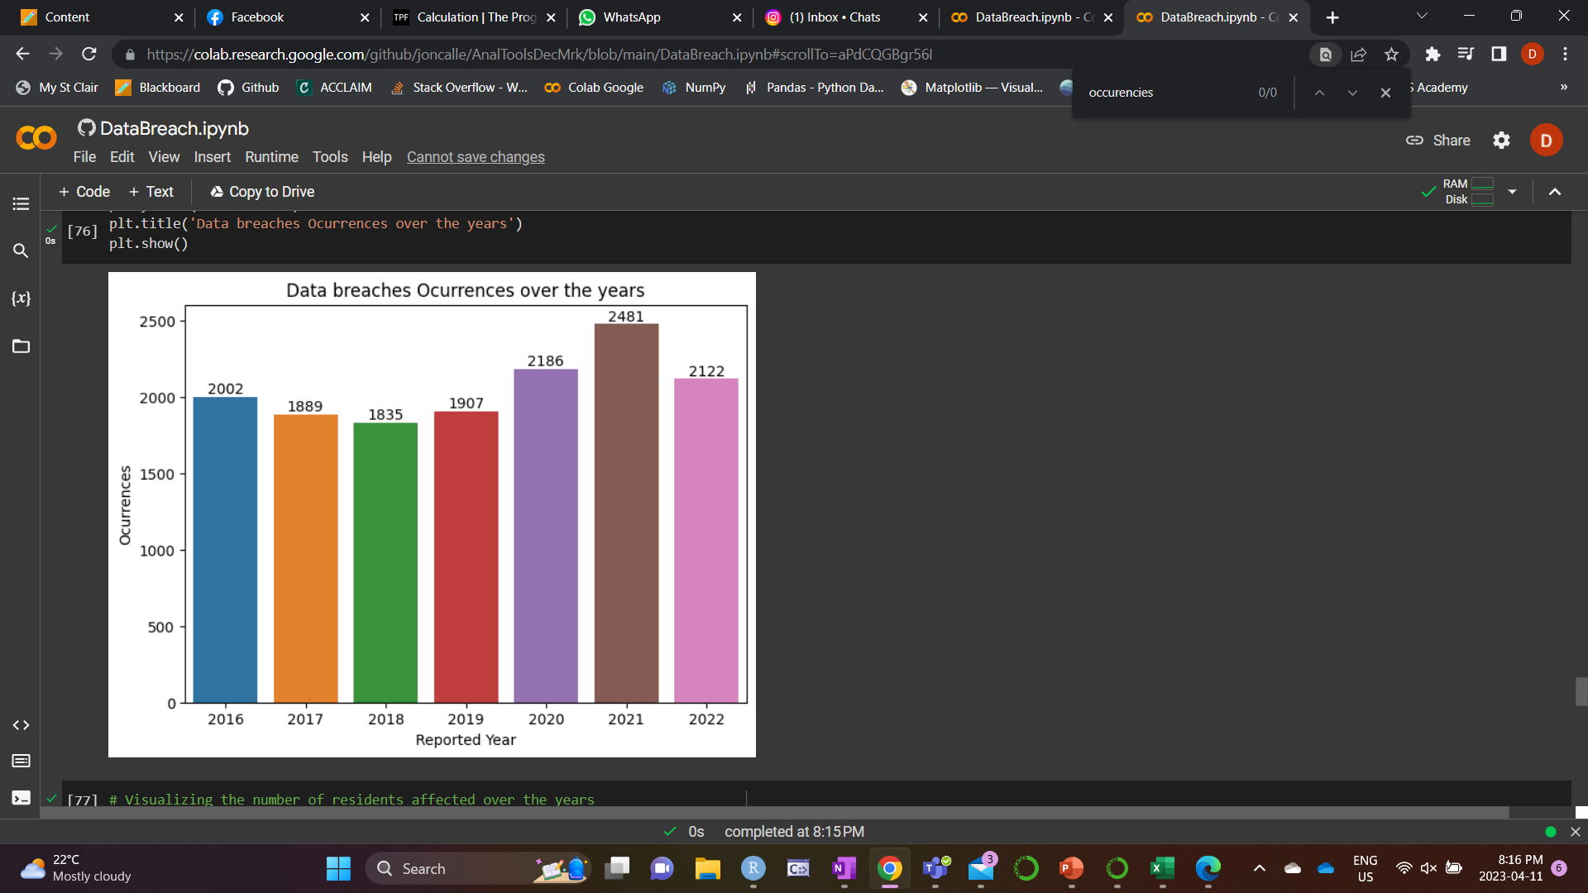
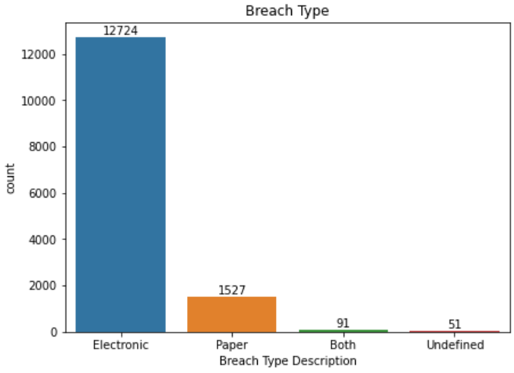
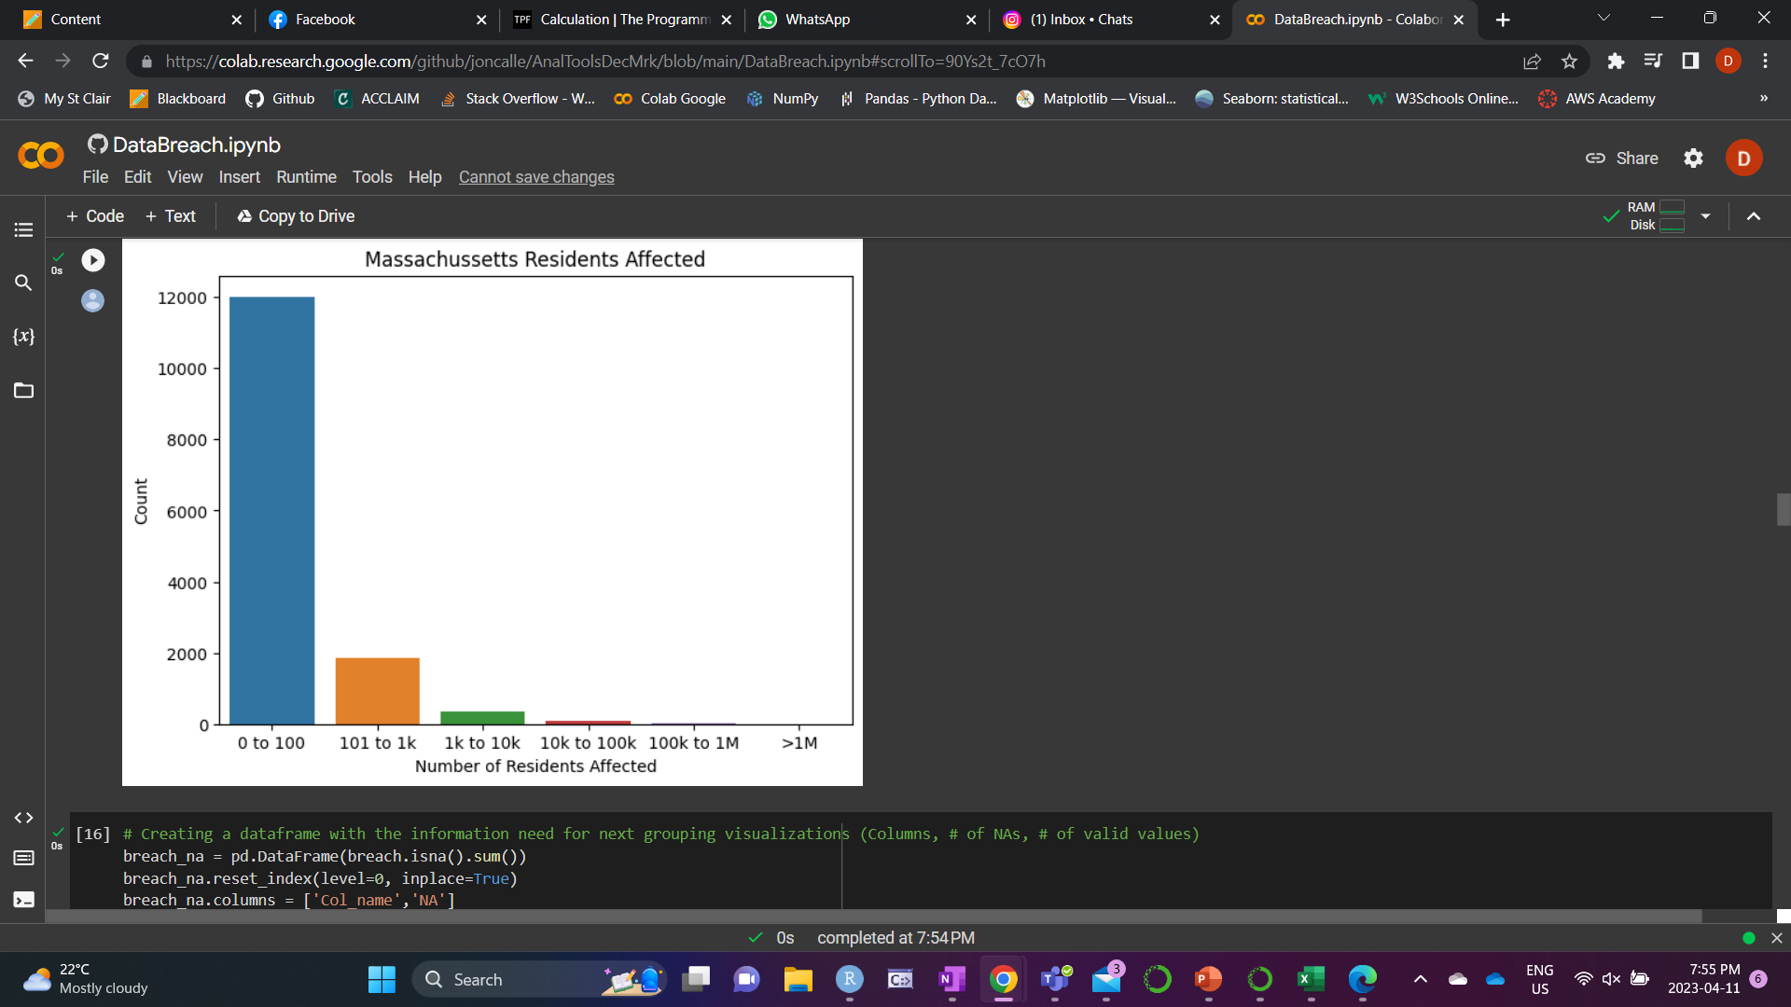
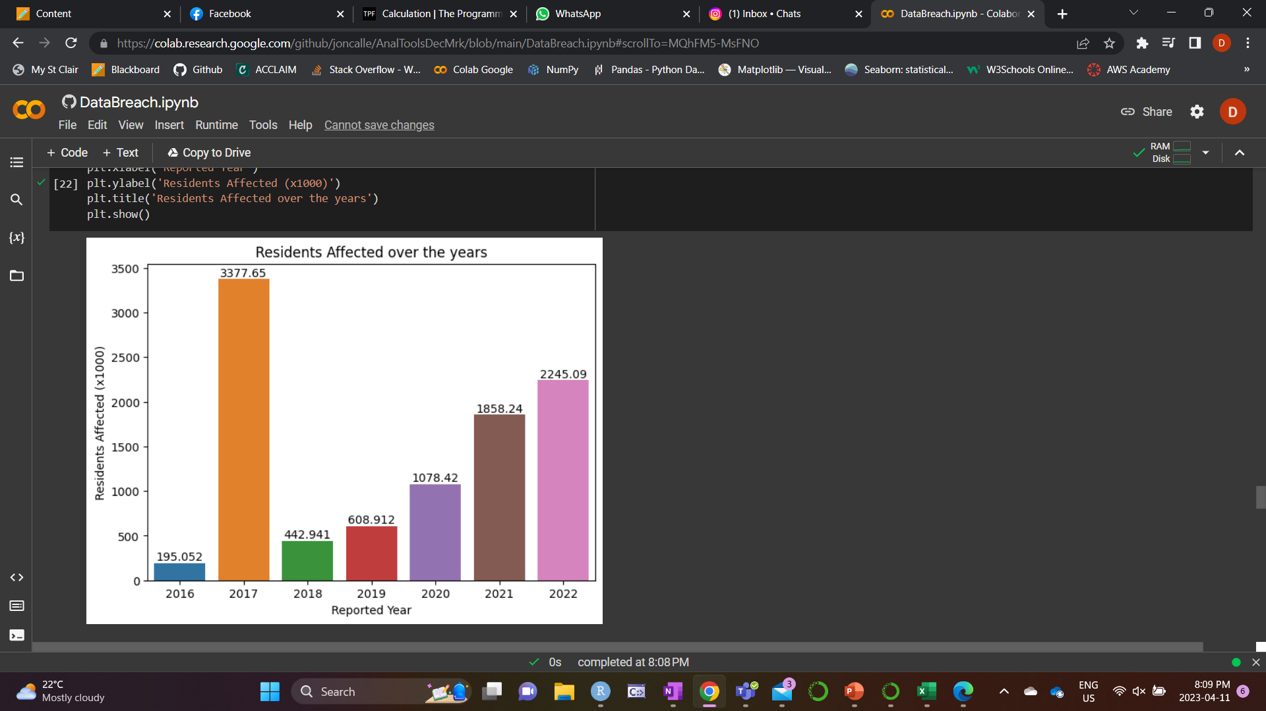
UNDERSTANDING THE DATA
Visualization Examples
Groups
Breach Types
Number of Residents Affected
Breaches of Social Security Number (Y/N)
Breaches of Account Number (Y/N)
Breaches of Driver’s License Number (Y/N)
Breaches of Credit/Debit Card (Y/N)
Number of Residents Affected over the Years
Number of Data Breaches Occurrences over the Years

Slide 10
Cleaning and Transforming THE DATA
Data Wrangling
What? | Why?
Replacement of NaN by “No” in the columns: Breach Occur at the Reporting Entity? SSNBreached Account Number Breached Drivers Licenses Breached Credit Debit Numbers Breached Provided Credit Monitoring Mobile Device Lost Stolen | These dataset’s columns are filled only when the answer is “Yes” , so when the answer is “No”, they are empty.
Deletion of 85 rows with NaNs in the column MA Residents Affected | We didn’t have information to fill this data accurately.
Filter Breach Type Description for electronic or both | The subject choose for our project is electronic data breaches, so we’ve removed paper and undefined type of breach from our dataset.
Creation of a new column Reported Year | The column Date Reported To OCA is on the format YYYY-MM-DD and is not a good format to use in visualizations.
Renown of columns’ names by replacing spaces with _ | Allows access the columns using [] and dot, accommodating the code style the person prefer.

Slide 11
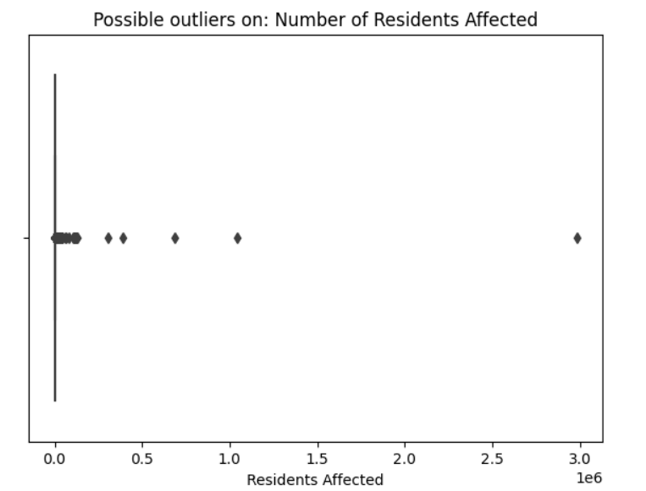
Cleaning and Transforming THE DATA
Outliers
We identified possible outliers in the MA Residents Affected column, but we chose to keep it because they are legitimate values and would negatively interfere with the analysis and conclusion.

Slide 12
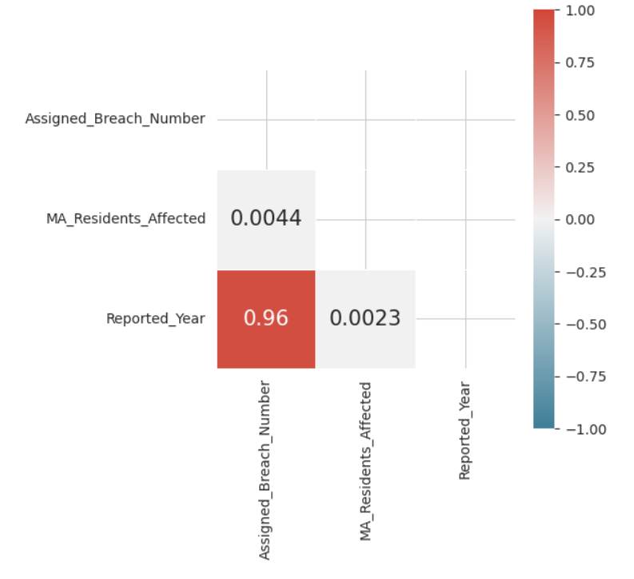
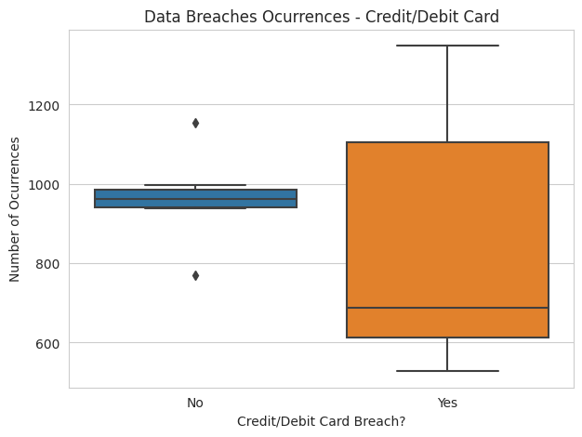
Analyzing THE DATA
Patterns
The strong positive correlation between the Year and the Assigned Data Breach is obvious because the number of the occurrence is incremental and unique, so the number of years increase, and the “id” of the data breach also increase, because new occurrences are added to the dataset.
Most of the Data Breaches Occurrences have the Credit/Debit Card number stolen.

Slide 13
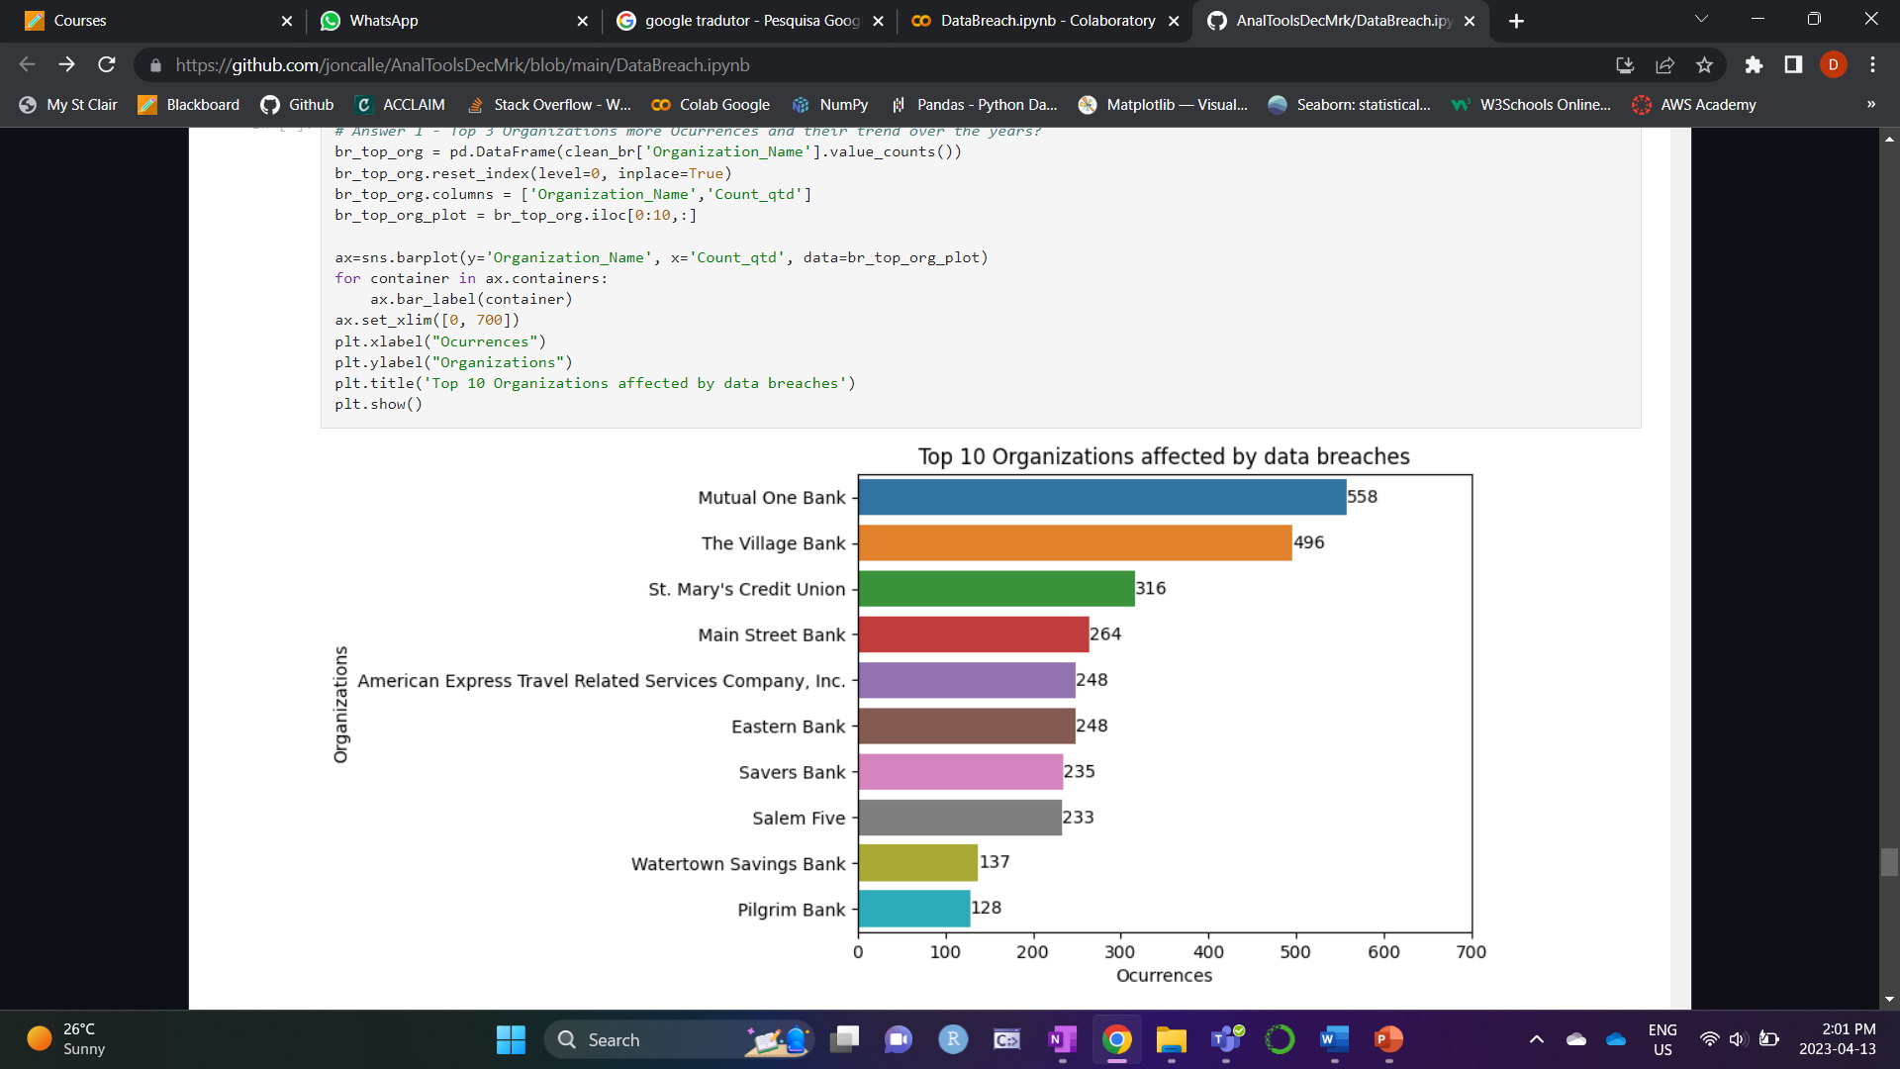
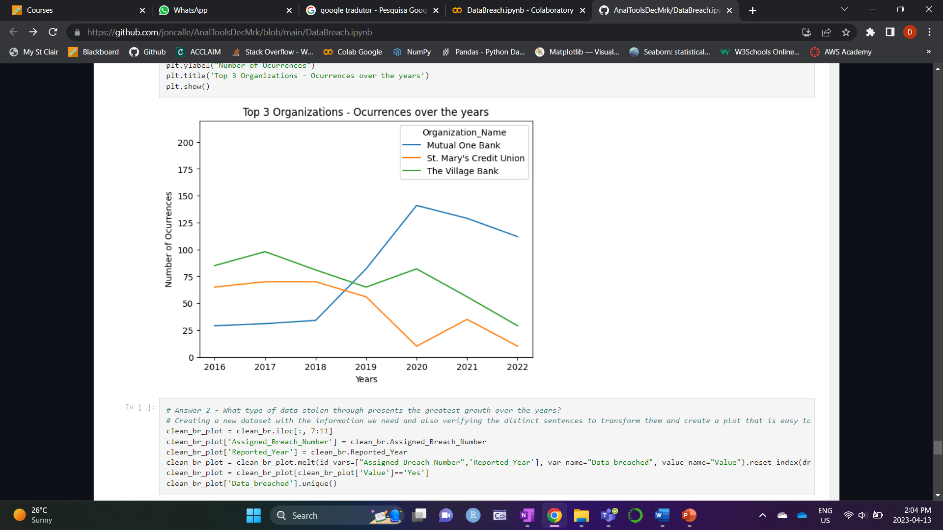
Analysis output
What are the Top 3 companies that suffered most of the data breaches and what is the trend for these companies?
Mutual One Bank experienced the highest number of breaches among the listed organizations, followed by The Village Bank and St. Mary's Credit Union. Interestingly, during the period of 2016-2018, Mutual One Bank had fewer breaches compared to the other organizations, however, from 2018 to 2022, the number of breaches increased significantly, placing it at the top of the list. The Village Bank and St. Mary's Credit Union were able to effectively manage and reduce the number of breaches they experienced over the same period.

Slide 14
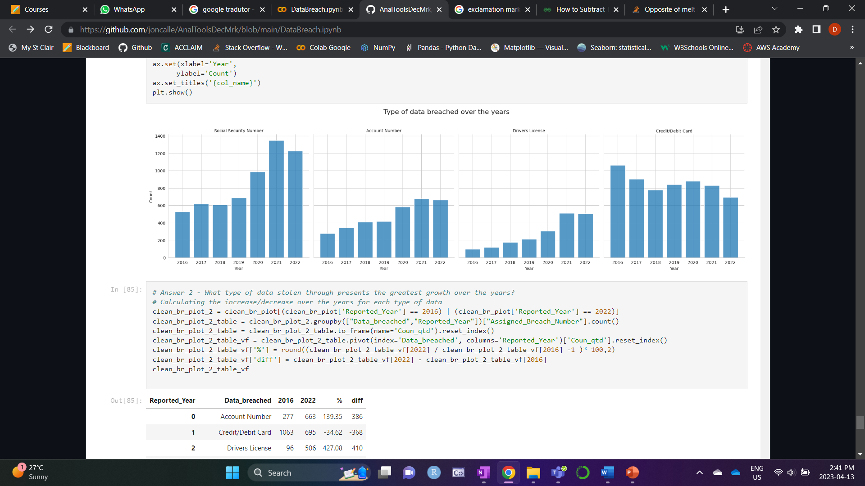
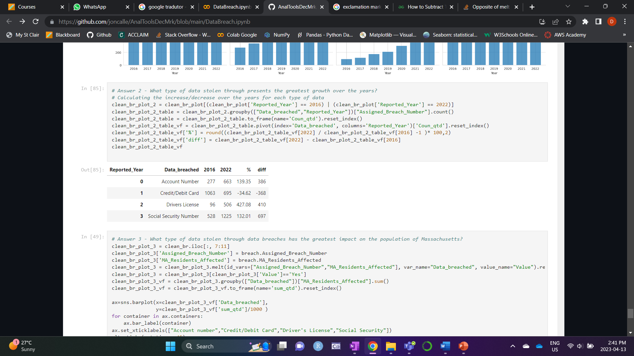
Analysis output
What type of data stolen through data breaches presents the greatest growth over the years?
There is a shift in the prevalence of information breaches over time. In 2016, stealing Credit/Debit card information was the most common form of breach, followed by stealing Social Security Numbers (SSNs). However, over the years, there was an increase in the number of SSN breaches by 132%, placing it at the top of the list. At the same time, the number of Credit/Debit card breaches decreased by 34% compared to 2016. On the other hand, we can notice that the Drivers License breaches has increased more than 400% and Account Number has increased for 139% over the past years

Slide 15
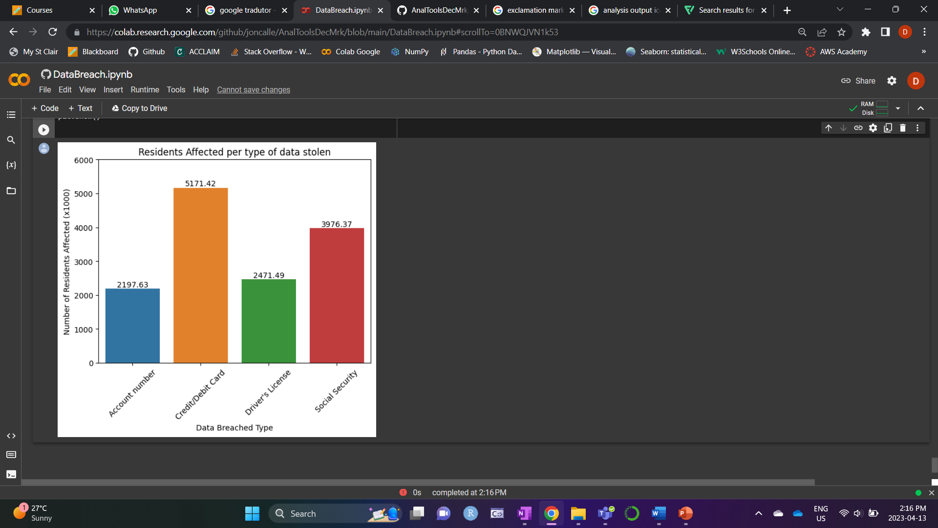
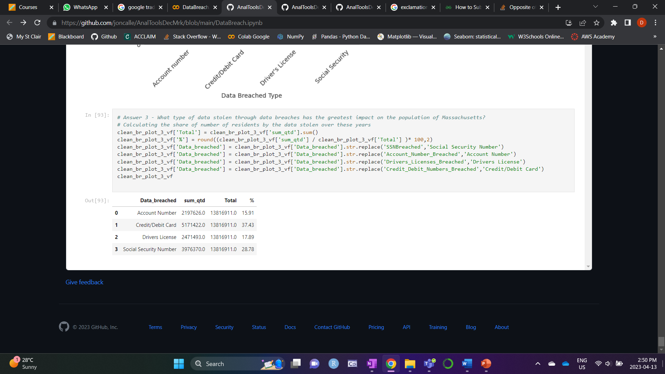
Analysis output
What type of data stolen through data breaches has the greatest impact on the population of Massachusetts?
Based on the available data from 2016 to 2022, the most common type of data breach experienced by individuals is Credit/Debit card (~38%) and the second most common type of data breach during this time period was related to Social Security Numbers (SSNs)

Slide 16
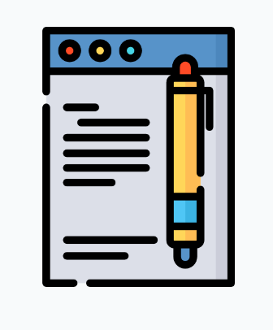
Conclusion
The Top 3 Organizations that have suffered more data breaches are Mutual One Bank, The Village Bank, and St. Mary's Credit Union.
Mutual One Bank had fewer breaches in the period of 2016-2018 however the number of breaches significantly increased in the following years, now it is on the top of the list.
The Village Bank and St. Mary's Credit Union were able to reduce the number of breaches they experienced compared to their 2016.
In terms of the type of data stolen:
Credit/debit card information was the most common form of breach in Massachusetts from 2016-2018 but the interest seems to be changed to other types of data.
SSN breaches surpassed Credit/Debit card breaches, Drivers License breaches has increased more than 400% and Account Number has increased for 139% over the past years, indicating a shift in the focus of perpetrators.
Data breaches have become an increasingly prevalent issue in Massachusetts over the years and brings severe consequences for individuals, including financial loss and damage to their credit history. Therefore, individuals and organizations must take appropriate measures to safeguard their personal and sensitive data to prevent data breaches and minimize their impact.

Slide 17

RECOMENDATIONS
Mutual One Bank doesn't seem to have efficient data breach protections unlike the other Top 3 companies. The organization should remain focused on data protection in general but especially Social Security number, Driver’s License number, which is apparently a given that it has been drawing the attention of hackers, as well as the Account number.
To effectively protect them, the following recommendations can help:
Restrict access – Make sure that only those who really need the data can access it, this knowledge and governance are of paramount importance.
Improve general security – Use VPNs, Firewall, traffic monitoring and restrictions, including the third parties’ connections, and other techniques to difficult the access.
Train employees – About 88% of breaches are caused by human error, so employees need to know how to detect and prevent threats, and how to protect data by following good practices such as creating strong passwords and not sharing them, for example.
Audit and reevaluate – The cyber threats change over time, also the employees come and go, new systems are implemented, and this means that the company needs to audit and reevaluate every aspects of its security recurrently.
Personal Identifiable Information (PII) – Follow the guidance on the Protection of Personal Identifiable Information. PII is defined as information: that directly identifies an individual (e.g., name, address, etc.) or by which an agency intends to identify specific individuals in conjunction with other data elements, i.e., indirect identification. (These data elements may include a combination of gender, race, birth date, geographic indicator, and other descriptors)

Slide 18
references
Solis, S. (2022). In Massachusetts, data breaches, threats on the rise. Axios Boston. https://www.axios.com/local/boston/2022/06/29/massachusetts-data-breaches-threats-on-rise
Mass.gov. (2023). Data breach reports. Massachusetts Government.
https://www.mass.gov/lists/data-breach-reports
Malegislature. (2007). Section 2: Regulations to safeguard personal information of commonwealth residents. The 193rd General Court of the Commonwealth of Massachusetts.
https://malegislature.gov/Laws/GeneralLaws/PartI/TitleXV/Chapter93H/Section2
Thomas, N. (2023). Privacy Litigation 2022 Year in Review: Data Breach Litigation. Morrison Foerster.
https://www.mofo.com/resources/insights/230125-year-in-review-data-breach-litigation
Pagnotta, S. (2022). What’s the cost of a data breach?. Bit Sight.
https://www.bitsight.com/blog/cost-of-data-breach
NA. (2021). Pandas.cut() method in Python - GeeksforGeeks. Geeks for Geeks.
https://www.geeksforgeeks.org/pandas-cut-method-in-python/
Nead, N. (2021). How To Prevent A Data Breach In Your Company. Forbes.
https://www.forbes.com/sites/forbesbusinesscouncil/2021/07/30/how-to-prevent-a-data-breach-in-your-company/?sh=51f19c1018da

